Slide 1
Basic circuit laws
Ohm my god do we really have to do this?

Slide 2
Batteries

Slide 3
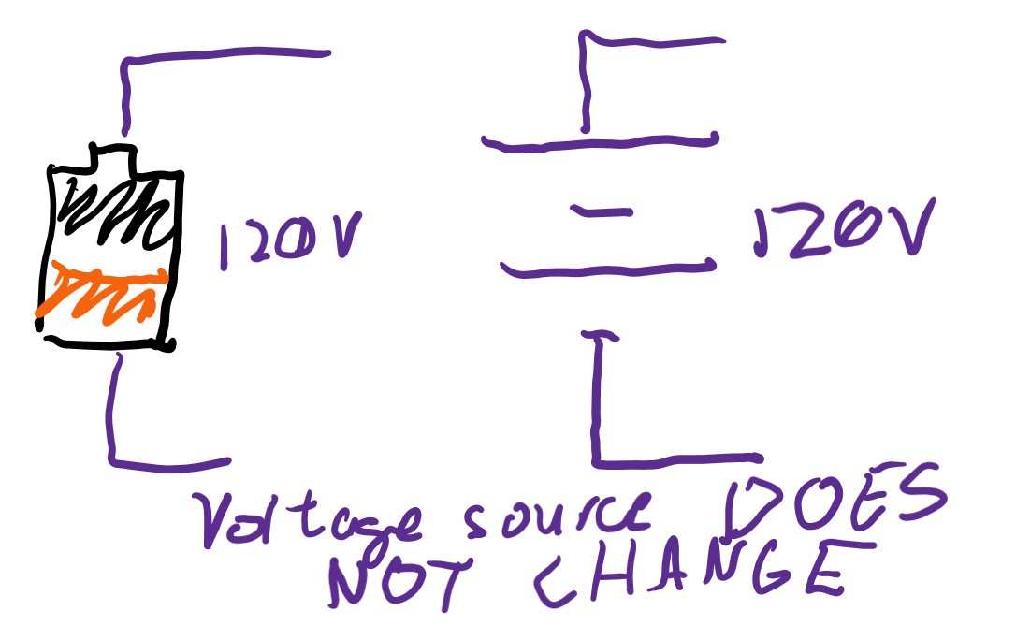
Voltage provided
Batteries try to keep the rate at which the chemical reaction happens constant. What does that mean about the voltage source?
Why is it important that the voltage a battery provides is constant?

Slide 4
Resistors

Slide 5

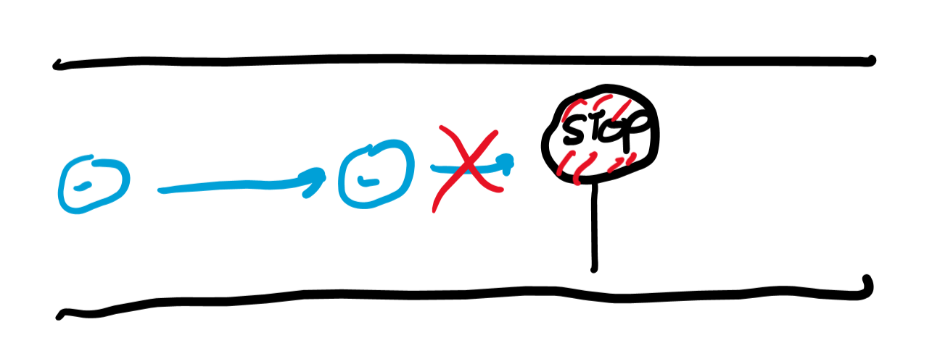
Slow down flow
What happens if nothing slows down traffic flow?
What if nothing slows down electrical flow (current)?
Resistors “resist” electrical flow, slowing it down.

Slide 6

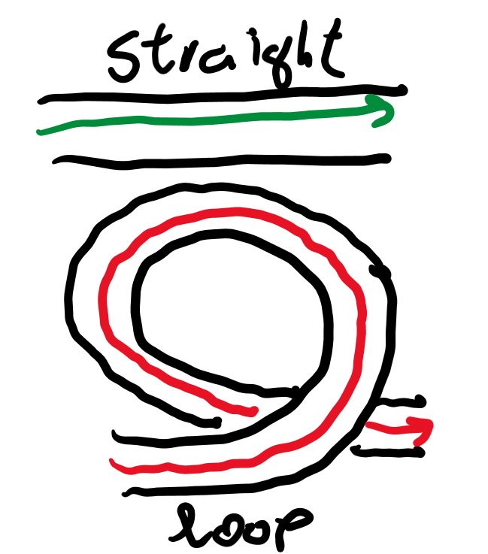
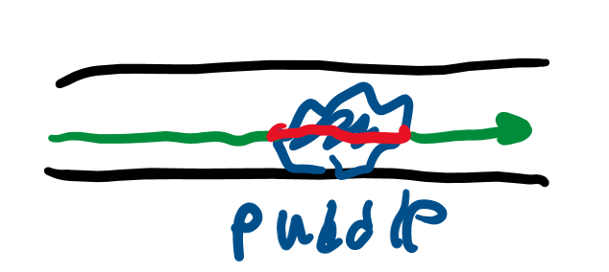
What slows down traffic?
What’s faster, going across a straight, 3 km road or looping around a bunch of times around a 27 km loop?
Can more cars travel across a wide or narrow road?
How might road conditions affect traffic?

Slide 7
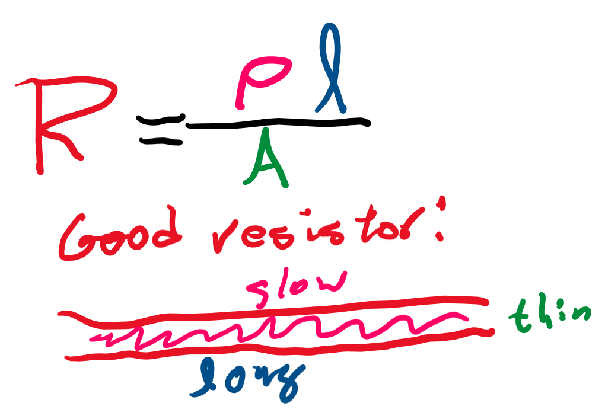
Resistance
The longer the resistor, the better a resistor it makes.
Thinner resistors are better because they let less current through.
“Resistivity” tells you the “road conditions” of a resistor. The larger the resistivity, the more it makes current move slower.

Slide 8
Voltage, current, resistance

Slide 9
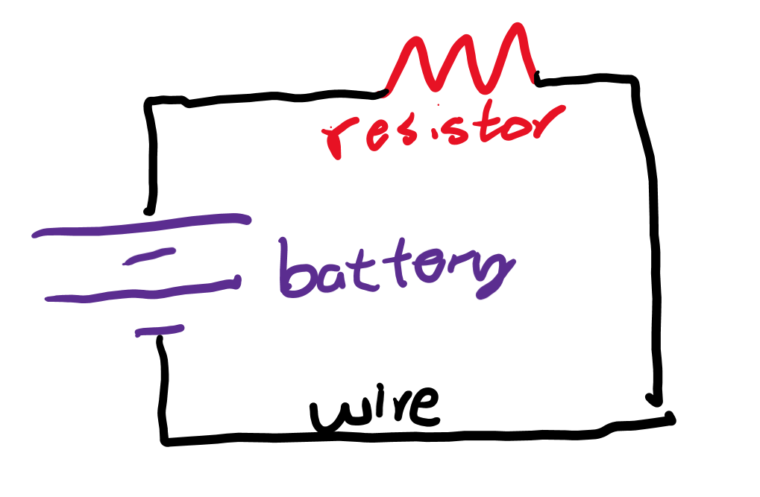
All parts combined
Let’s combine a capacitor, wire, and resistor together.
What provides the voltage source?
What lets current pass through?
What provides the resistance source?

Slide 10
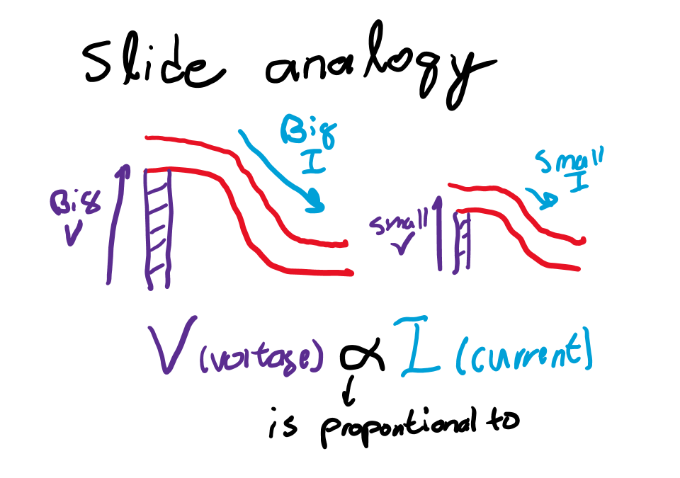
Ohm’s law
If you increase voltage, how do you expect current to change?
As increasing voltage increases current, we say voltage is “proportional” to current!

Slide 11
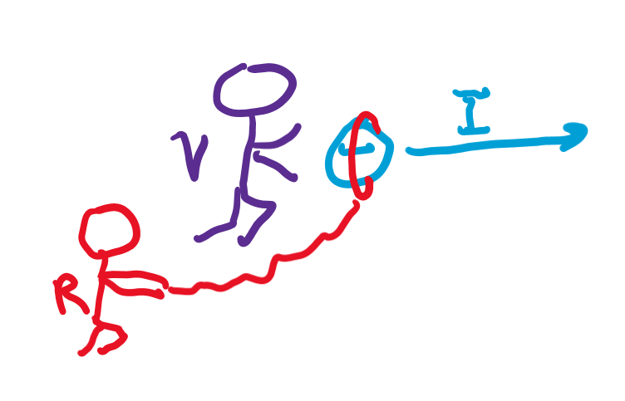
Formal definition of resistance
If you increase voltage by 5 V, how much does your current increase?
We can’t answer the question above! We need to know how much increasing voltage increases current!
R = V/I. In other words, resistance is how much voltage it takes to increase current by 1 A.

Slide 12
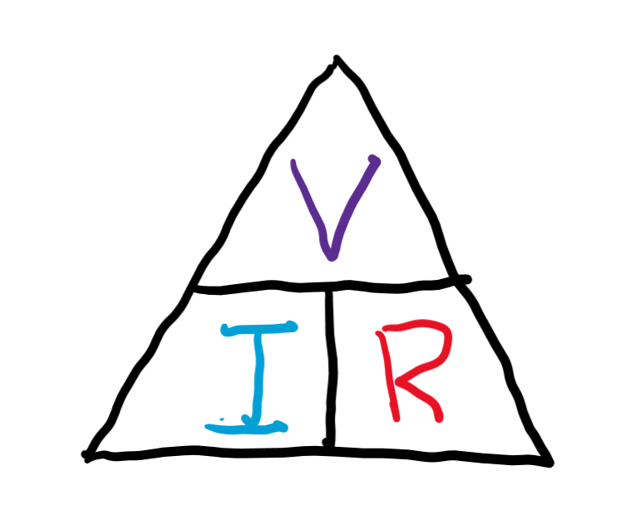
Basic circuit equation
V = IR, or I = V/R, or R = V/I.
Let’s answer the previous question: if voltage is increased by 5 V and we know that resistance is 5 ohms, what is current?
The triangle tells us I = V/R = 5 volts/5 ohms = 1 A.

Slide 13
Kirchhoff’s first law

Slide 14
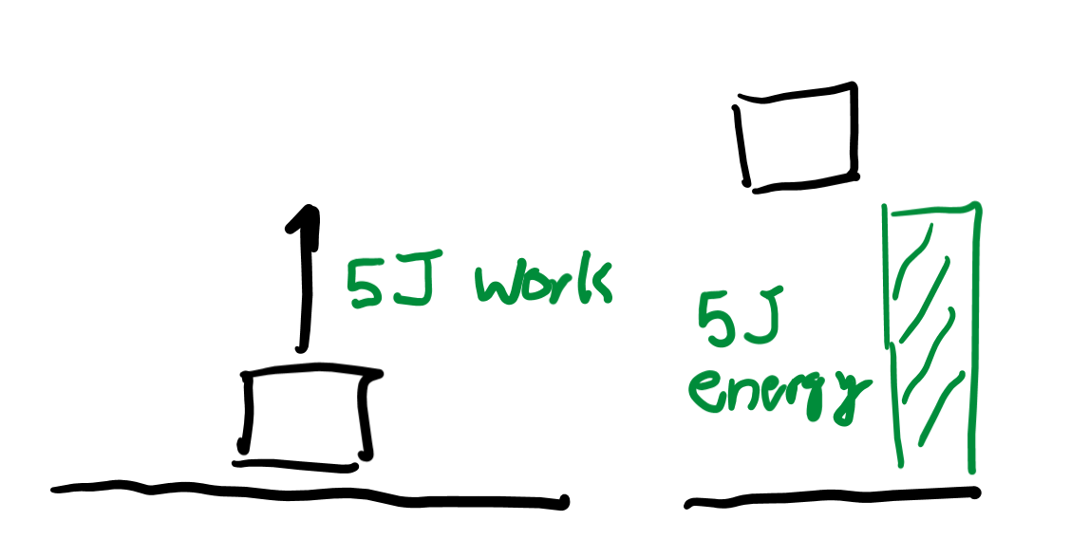
Conservation of energy
If I put in 5 J of energy to raise a block, how much potential energy will it have?
The amount of energy going in has to be the same as the amount of energy going out.

Slide 15
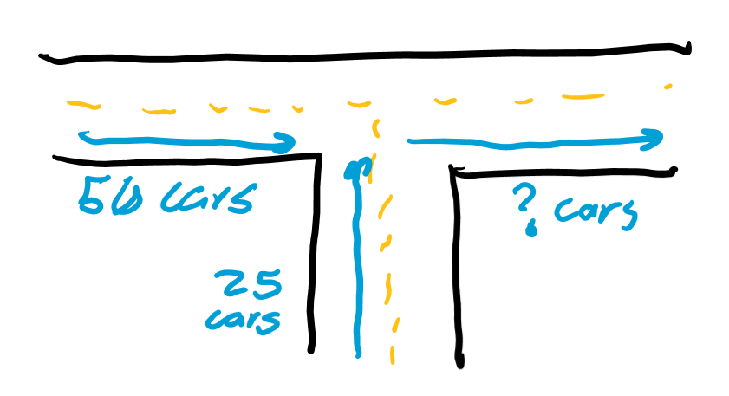
Traffic junctions
Imagine an intersection where 50 cars go in on one side and 25 cars go in from another lane. How many cars have to go out the other side?
What happens if 75 cars don’t leave the intersection?

Slide 16
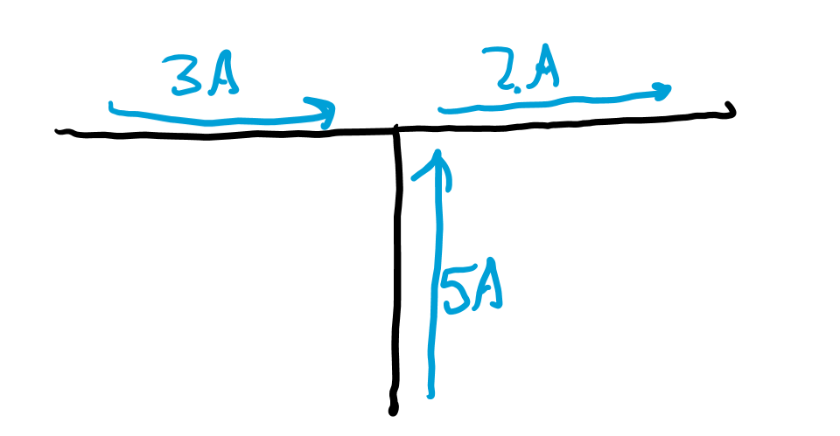
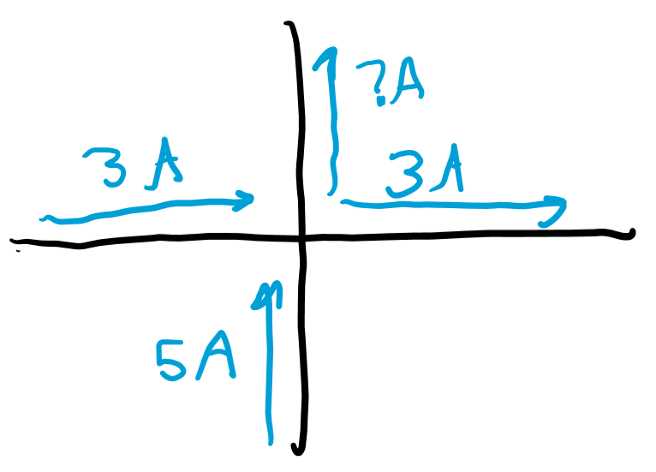
Current flow
Current junctions are just like traffic intersections! If 3 amps go in one wire and 5 amps go in another wire, how much current has to be leaving?
If current can leave through two lanes and one wire has 3 amps leave, how many amps leave through the other wire?

Slide 17
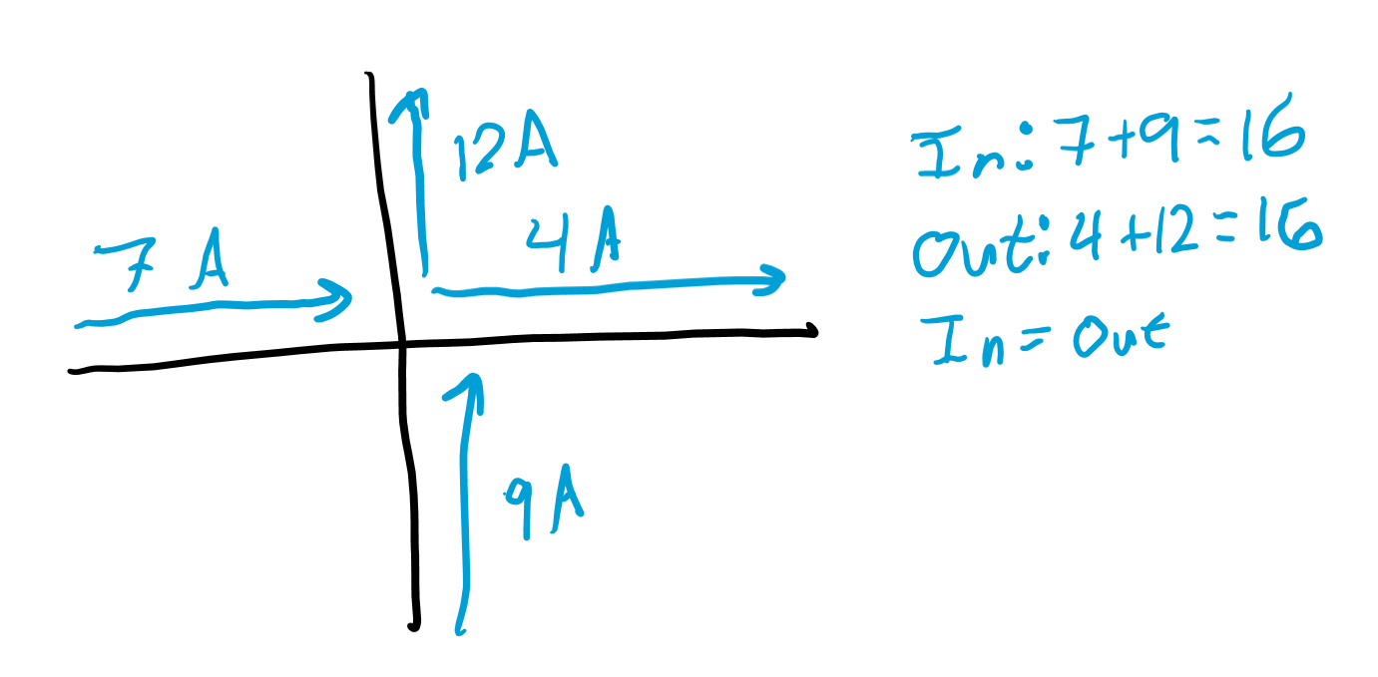
Junction rule
This is the “formal” definition of Kirchhoff’s first law: the current going in a junction must equal the current leaving a junction.

Slide 18
Kirchhoff’s second law

Slide 19
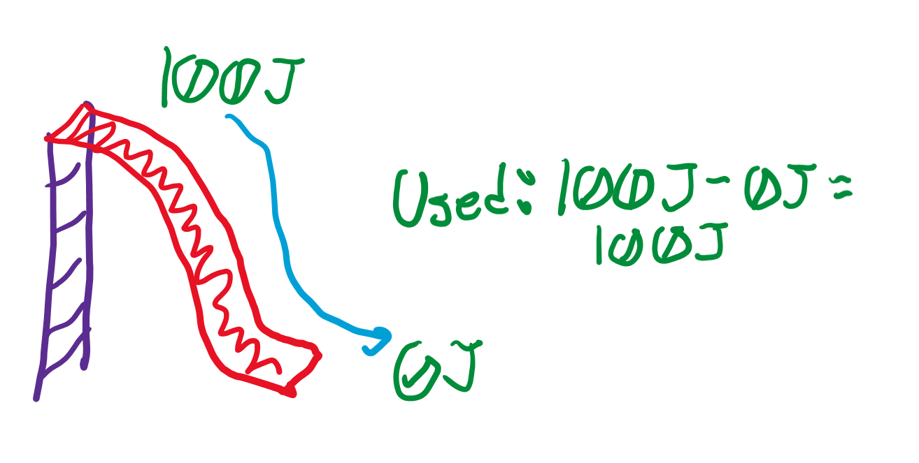
Energy on a slide
If you start with 100 J of potential energy on the top of a slide, how much potential energy do you use when you slide down?
Why is it not possible to use more than 100 J of potential energy? Less?
Hint: law of conservation of energy!

Slide 20
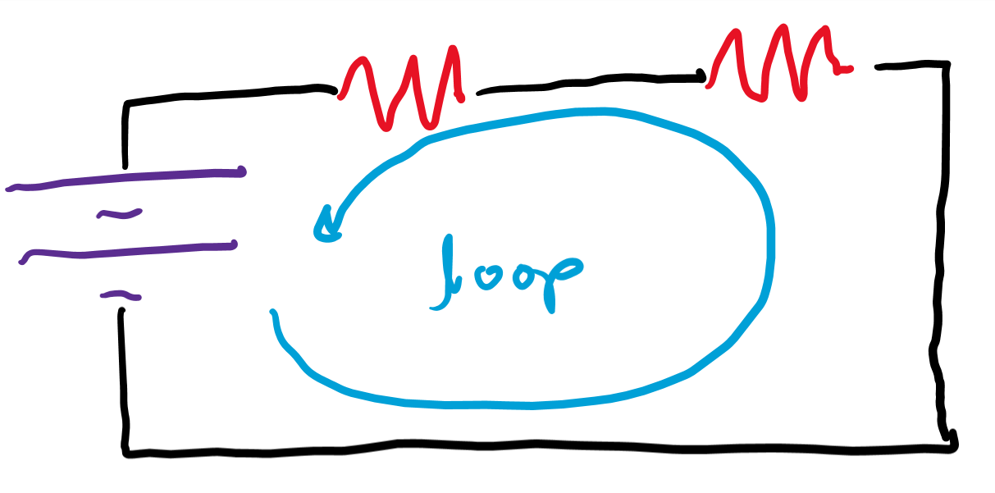
Energy from a voltage source
If 12 volts of energy are supplied, how much is used up as we go across the circuit?
Where do you think we lose voltage?

Slide 21
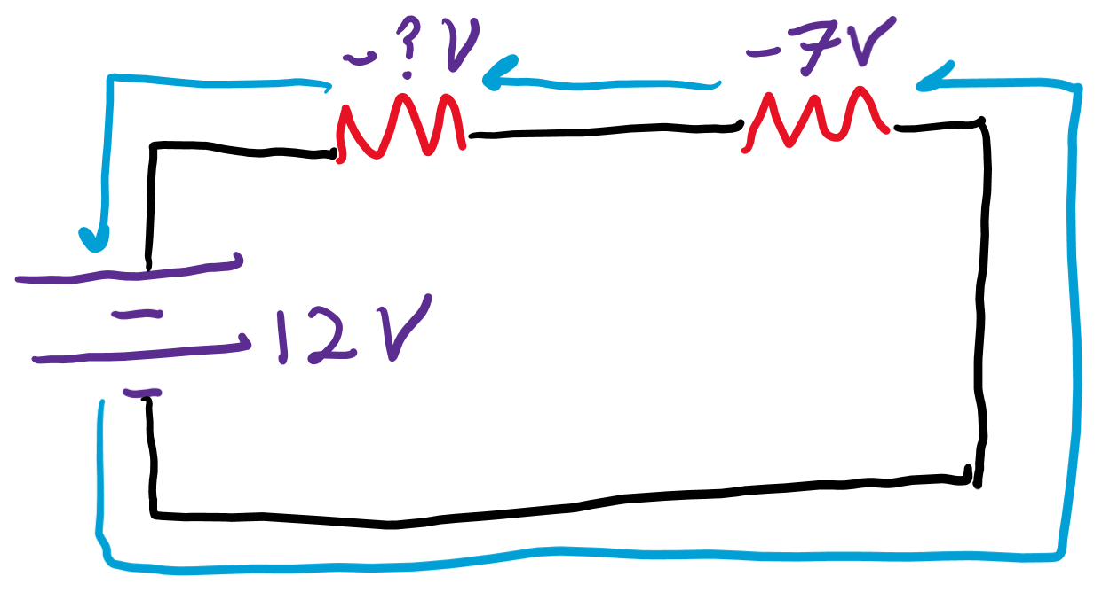
Finding voltage drops
If one resistor uses 7 volts of energy, how many volts does the other resistor have to use?

Slide 22
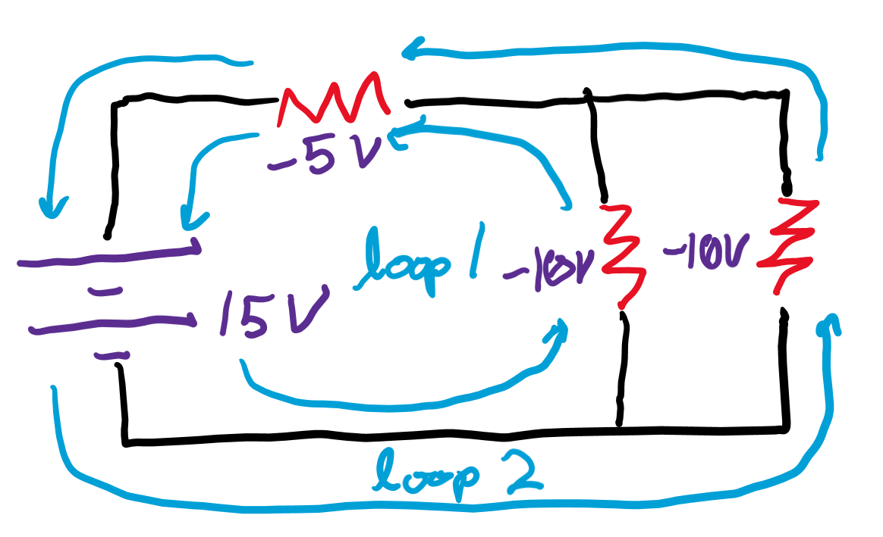
Loop rule
Formal definition of Kirchhoff’s second law: the sum of voltages across a loop is zero.
This means that the “drops” or negative voltages from resistors use up all the “positive” voltage supplied by a battery.

Slide 23
Simplifying complex circuits

Slide 24
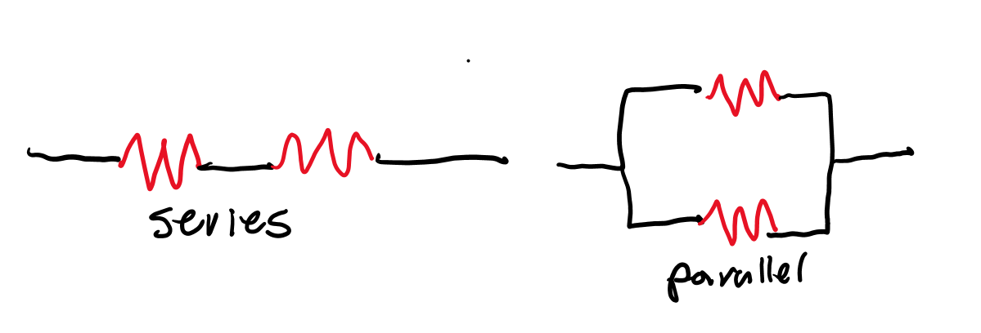
Series vs parallel
Series means everything is put in a row while parallel means there’s two tracks.

Slide 25
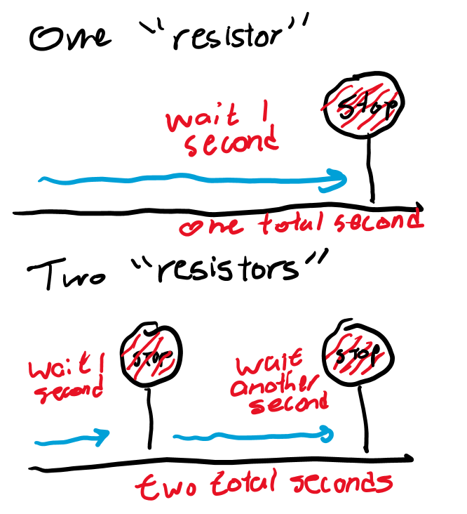
Resistors in series
If you have two stop signs right next to each other, is it faster or slower than a single one?
The resistances of resistors in “series” add together. R = R1+R2+. . .+Rn.
Derivation based on Kirchhoff’s loop rule.

Slide 26
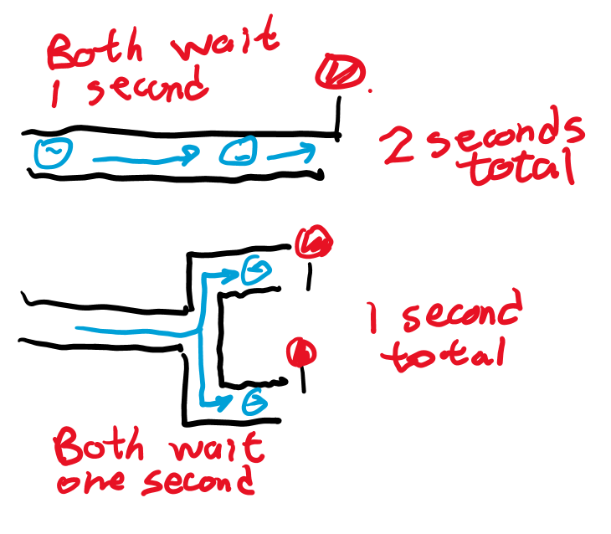
Resistors in parallel
If you go from having one lane with a stop sign to two lanes with a stop sign, can more cars get past?
Resistors in parallel add “harmonically” (get smaller as you add). R = 1/(1/R1+1/R2+. . .+1/Rn).
Derivation based on Kirchhoff’s junction rule.

Slide 27
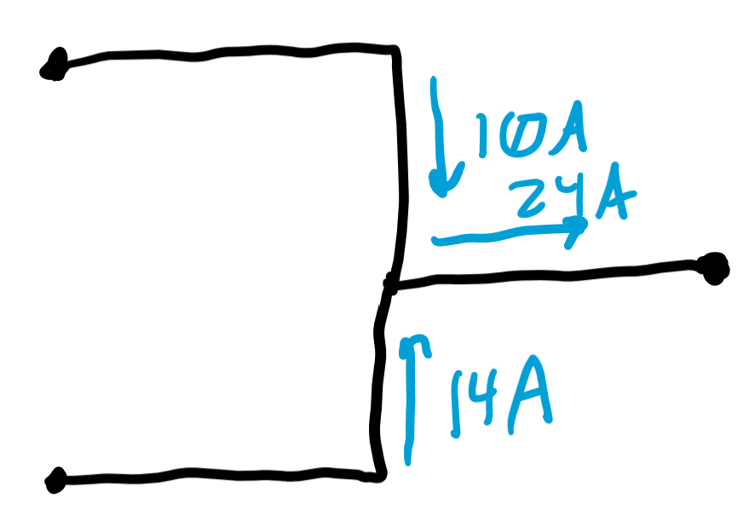
Thevenin’s rule
This tells you current sources add in parallel.
If one track provides 10 amps and another provides 14 amps, they can sum to a single track that provides 24 amps.

Slide 28
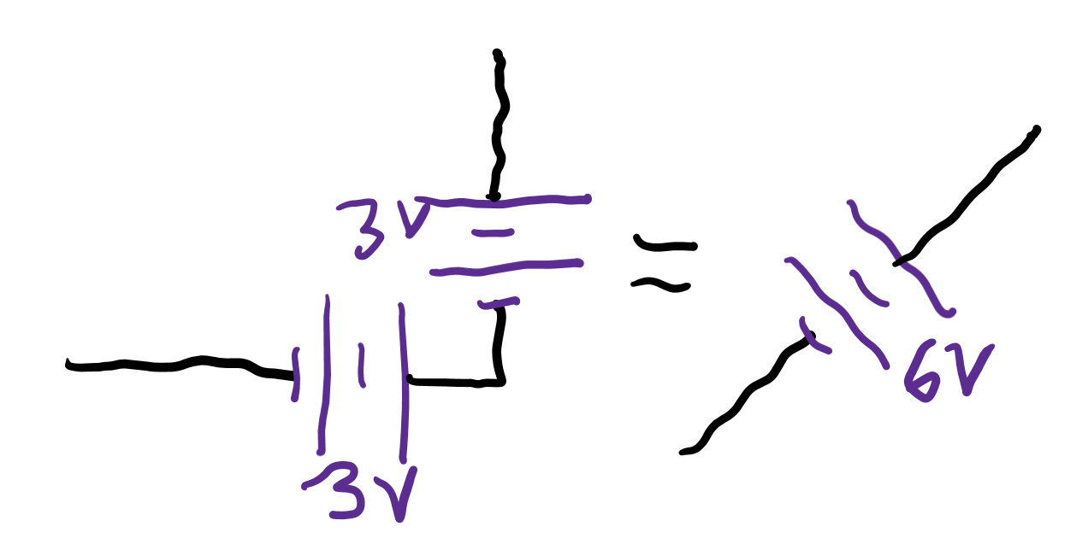
Norton’s rule
Voltages add in series.
If you put two batteries of 3 volts next to each other, that’s like you made a single voltage source of 6 volts!

Slide 29
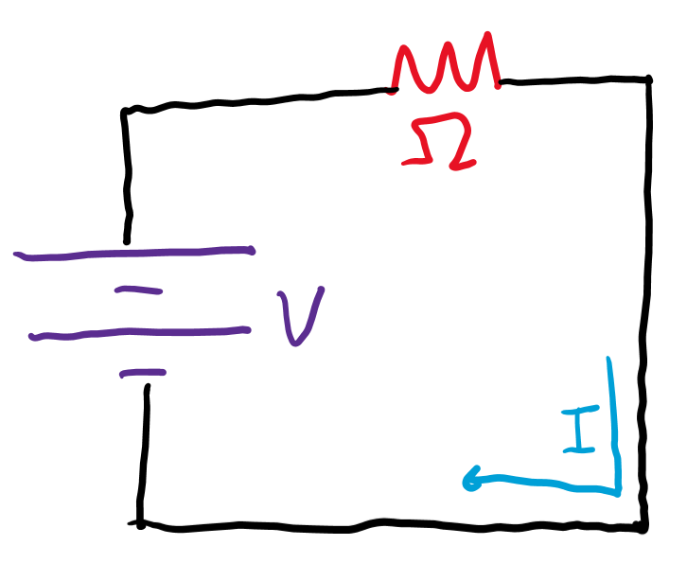
Most basic circuit
If we combine all the voltages, current, and resistances, we get a single circuit.
But what if we spice it up? What if we add some more circuits components?

